Slide 1
Codification Techniques
Notes:
Recap: Organizing and presenting knowledge , before it is accessed by authorized personnel, making corporate specific knowledge visible, accessible and usable for decision making, converting undocumented information to documented information etc

Slide 2

Knowledge Map
Knowledge mapping is about making knowledge that is available within an organization become transparent and giving the insights into its quality.
Knowledge map is a visual representation of knowledge. They can represent explicit/tacit, formal/informal, documented/undocumented, internal/external knowledge
Notes:
A knowledge map is a visual aid that shows where knowledge can be found within a group or organization, and how to find those with the most expertise. Often referred to as an “inventory of knowledge”, these maps are organized using various interconnected nodes to make it easy to find out where to look for information.

Slide 3
Knowledge Map
Knowledge map is all about keeping record of information and knowledge by data gathering, survey, exploring, discovery, conversation, disagreement, gap analysis, education and synthesis.
It illustrate or “map” how knowledge flow throughout an organization
It is a sort of directory that points towards people, documents, and repositories

Slide 4
Knowledge Map
Knowledge Map identifies:
explicit knowledge(knowledge artifacts)
tacit knowledge
infrastructure
organization

Slide 5
What do we map?
Explicit knowledge
subject
purpose
location
ownership
users
access right
Tacit knowledge
expertise
skill
experience
location
contact address
relationships/networks

Slide 6
Where does knowledge reside?
Correspondents
internal documents
Library
Archives (past project documents, proposals)
Meetings
Best practices
Experience
Corporate memory

Slide 7
Form of K-Map?
Graphic or stylized form
Flow chart
Organizational chart
Written context,….

Slide 8
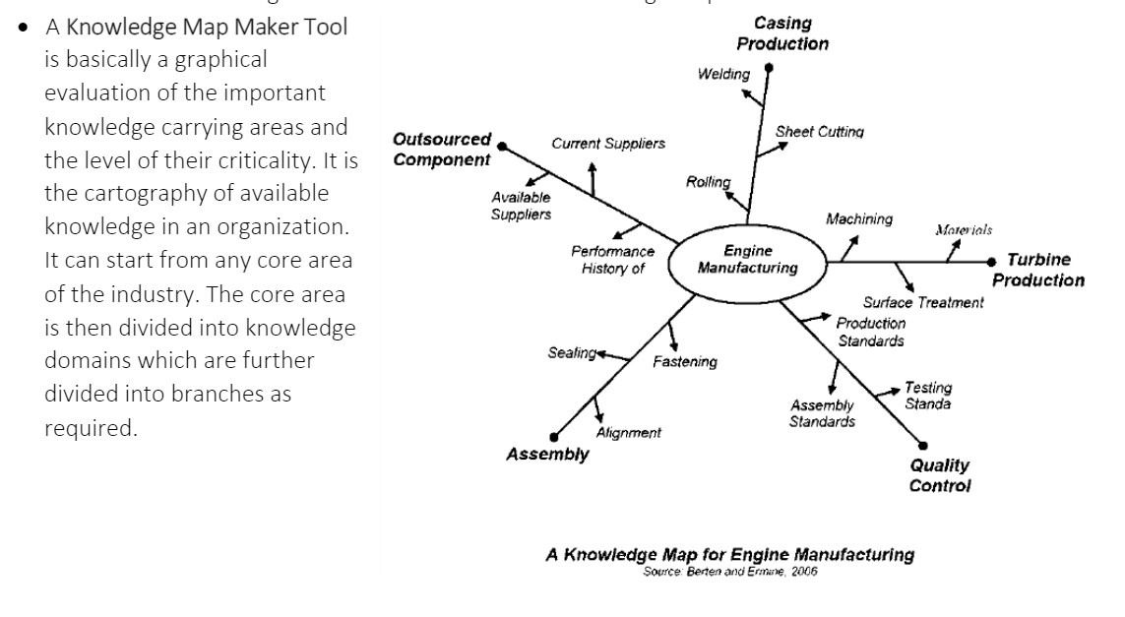

Slide 9
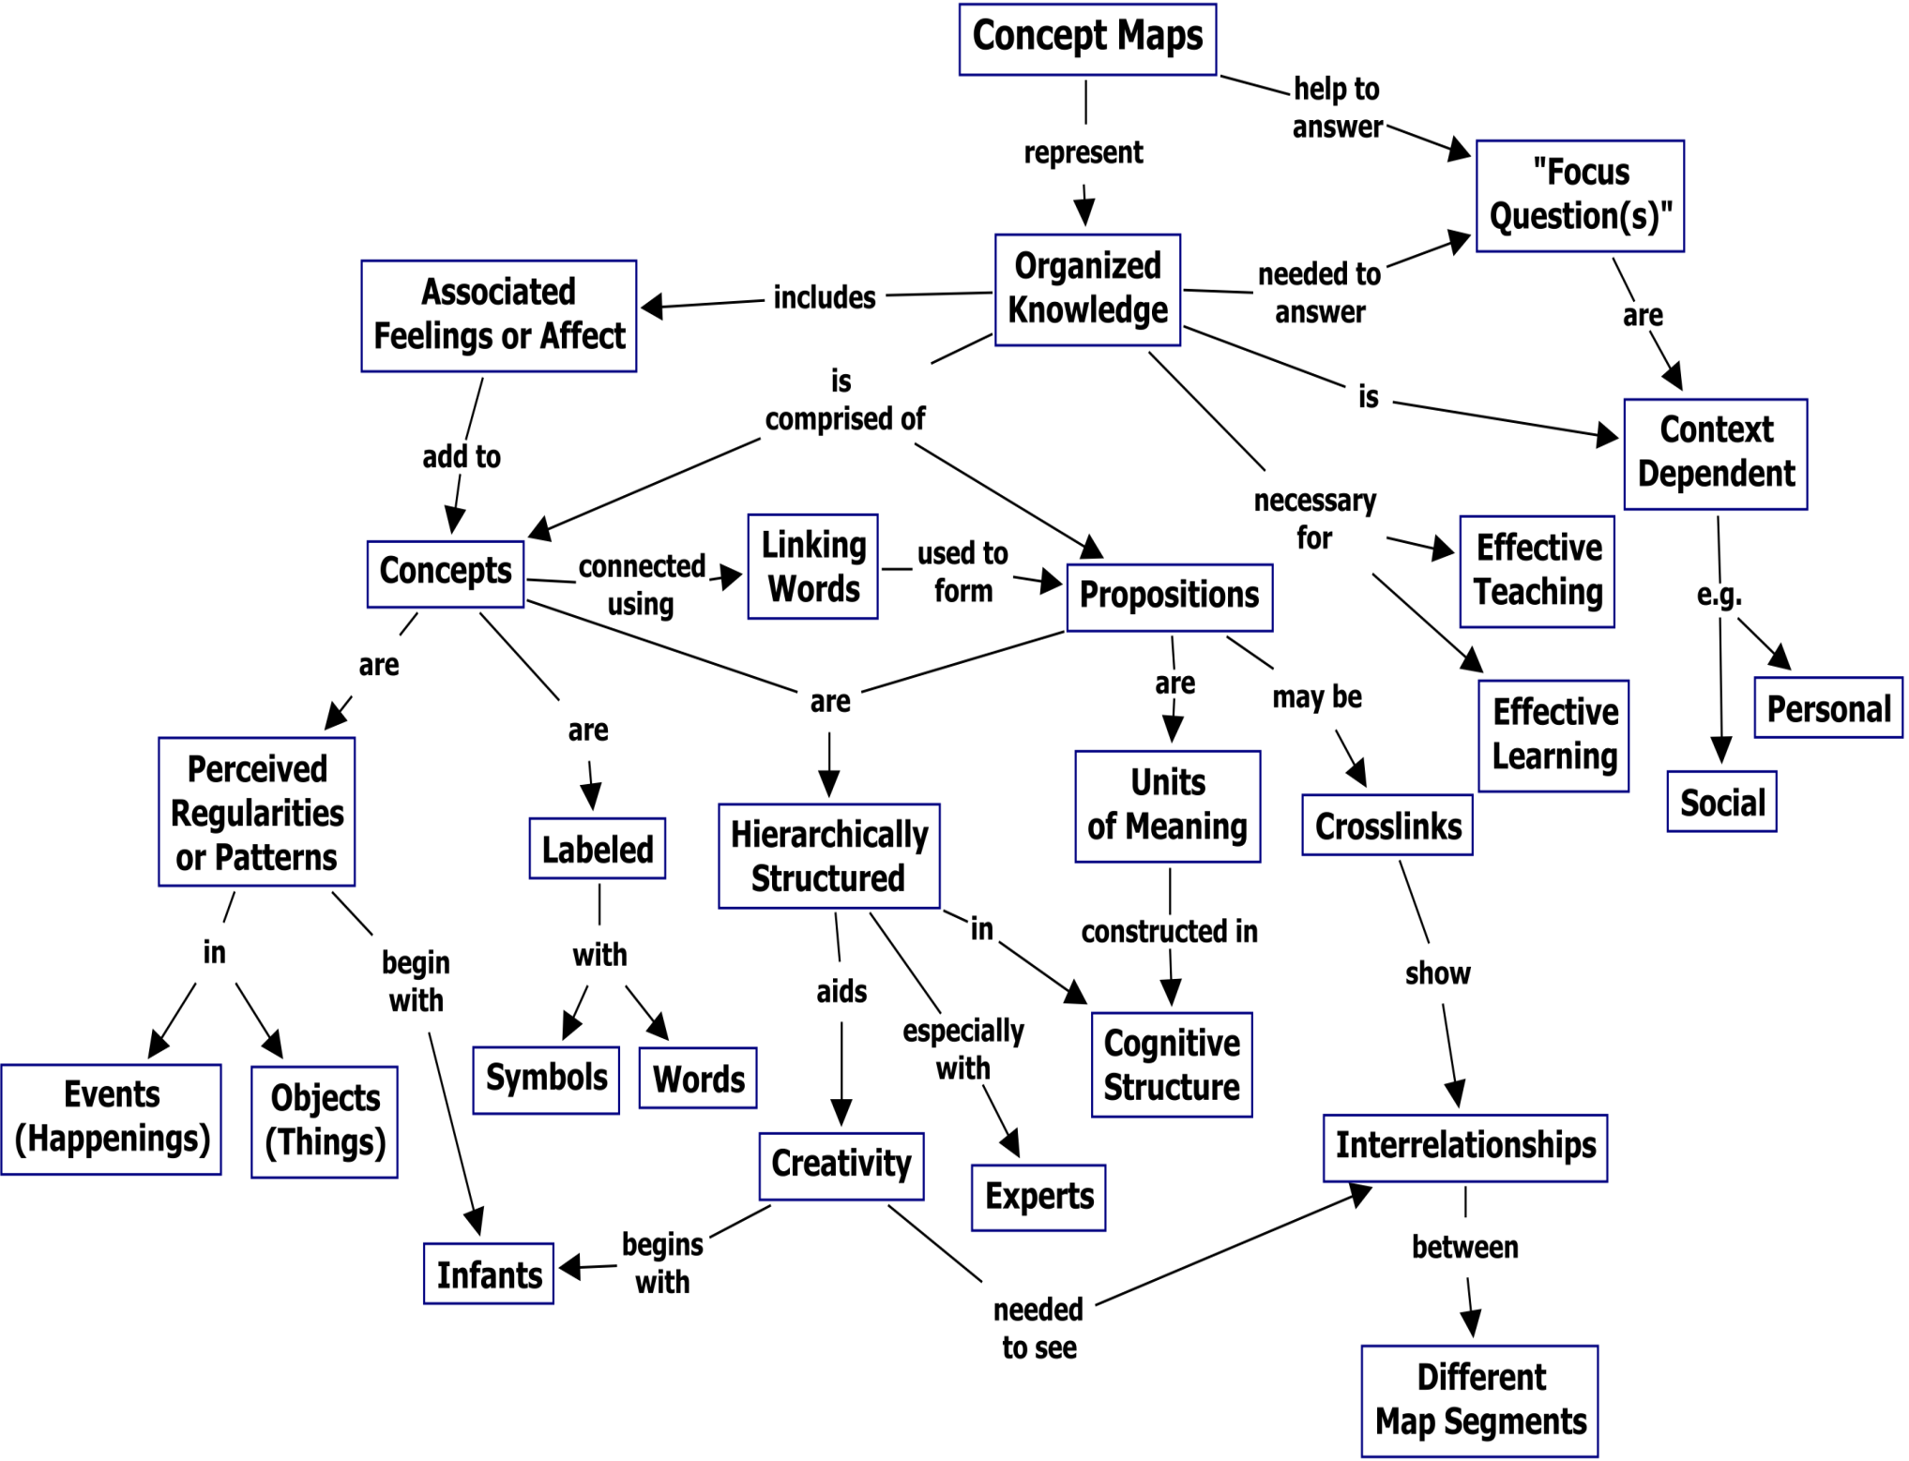

Slide 10
What do K-map show?
Available knowledge resources
Knowledge clusters and communities
Who uses what knowledge resources
The paths of knowledge exchange
The knowledge lifecycle
Knowledge gap

Slide 11
Benefit of K-Map
to find key sources of knowledge creation
to encourage reuse and prevent reinvention
to find critical information quickly
to highlight islands of expertise
to improve decision making and problem solving by providing applicable information
to give insights into corporate knowledge

Slide 12
Steps of creating K-Map
1)Review critical processes
2) Identify individual process steps within each process
3) Identify the knowledge required to fulfill the purpose of each process step
4) Identify the knowledge generated for each process step
5) Analyze the process maps (knowledge quality, knowledge sharing, ease of access, etc.)

Slide 13
Step of Creating K-Map (Cont.)
What knowledge is needed?
Who has this knowledge?
Where does this knowledge reside?
Is the knowledge tacit or explicit?
Is the knowledge routine or non-routine?
What issues does it address?

Slide 14
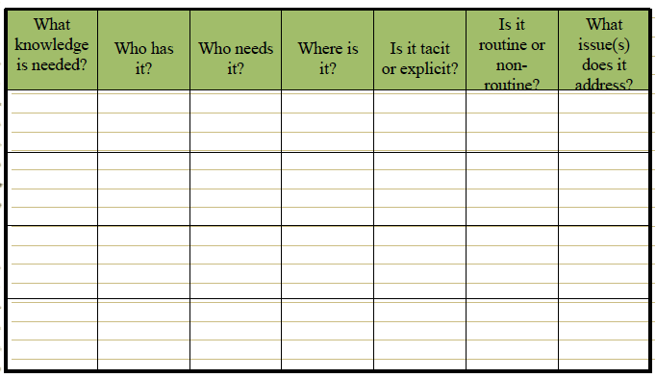
Knowledge Map Matrix

Slide 15
Analyze the process maps
Do we leverage this today?
Is the knowledge available and accessible to everyone who needs it?
Are decisions made with all the right knowledge?
Where should we focus our improvement efforts?
Summarize the analysis
Create list of key strengths
Create list of key opportunities for improvement and expected benefits
Notes:
The proces

Slide 16
Lesson Learned
Make sure people who are intimate with the organization and process are involved
High level mapping of the process you want to share knowledge around is key!
Update your “map” periodically –knowledge has a shelf life (people move, technology changes, etc.)

Slide 17
Decision Tables
It is another technique used for knowledge codification. It consists of some conditions, rules, and actions.
Example:
A phonecard company sends out monthly invoices to permanent customers and gives them discount if payments are made within two weeks. Their discounting policy is as follows:
``If the amount of the order of phonecards is greater than $35, subtract 5% of the order; if the amount is greater than or equal to $20 and less than or equal to $35, subtract a 4% discount; if the amount is less than $20, do not apply any discount.''
We shall develop a decision table for their discounting decisions, where the condition alternatives are `Yes' and `No'.

Slide 18
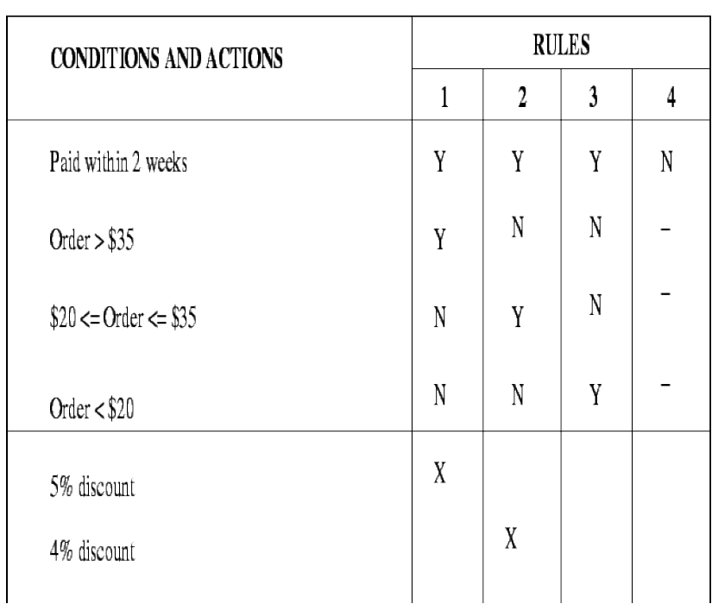

Slide 19
Decision Trees
Decision Tree
It is also a knowledge codification technique.
A decision tree is usually a hierarchically arranged semantic network.

Slide 20
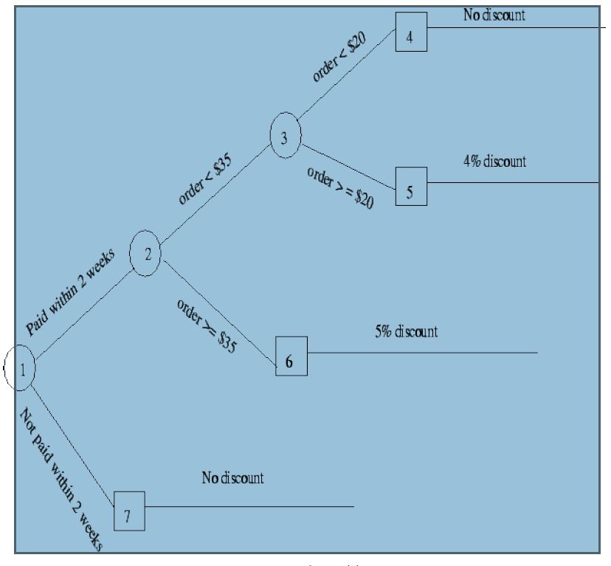
Decision tree for a discounted policy

Slide 21
Frames
A frame is a codification scheme used for organizing knowledge through previous experience. It is used to represent structured knowledge about a particular domain or situation.
It provides at way organize and describe information by encapsulating it in a structured format, often resembling a template or a schema. This technique is particularly useful for representing complex and context-specific knowledge in a way that is both systematic and easy to understand.
It deals with a combination of declarative and operational knowledge.
Key elements of frames:
Slot: A specific object being described/an attribute of an entity.
Facet: The value of an object/slot.
Notes:
Frames were introduced by Marvin Minsky in the context of artificial intelligence and cognitive psychology. They serve as data structures that capture stereotypical situations, objects, or events, allowing for the representation of knowledge in a modular and reusable way.

Slide 22
Structure of FramesA
Components:
Frame Name:
The identifier or title of the frame, which indicates the type of knowledge it represents.
Slots:
Attributes or fields within the frame that hold specific pieces of information. Each slot represents a property or characteristic of the entity described by the frame.
Slots can have default values, constraints, and conditions for their content.
Facets:
Additional information about the slots, such as data types, value ranges, inheritance properties, or attached procedures (methods) that describe how to handle the slot's value.

Slide 23
Example: a frame representing knowledge about a "Meeting":
Frame Name: Meeting
Slots:
Date: The date of the meeting.
Time: The time when the meeting will take place.
Location: The venue of the meeting.
Attendees: List of participants expected to attend the meeting.
Agenda: The topics to be discussed during the meeting.
Organizer: The person responsible for organizing the meeting.
Facets:
Date: Must be a valid calendar date.
Time: Should be specified in a 24-hour format.
Attendees: Should include at least one participant.
Agenda: Can be a list or a textual description.

Slide 24
Production Rules
They are conditional statements specifying an action to be taken in case a certain condition is true.
They codify knowledge in the form of premise-action pairs.
Syntax: IF (premise) THEN (action)
Example: IF income is `standard' and payment history is `good', THEN `approve home loan'.
A certainty factor is synonymous with a confidence level , which is a subjective quantification
of an expert's judgment.
The premise is a Boolean expression that should evaluate to be true for the rule to be applied.
The action part of the rule is separated from the premise by the keyword THEN.
The action clause consists of a statement or a series of statements separated by AND's or
comma's and is executed if the premise is true.

Slide 25
Case-Based Reasoning
It is reasoning from relevant past cases in a way similar to human's use of past experiences to arrive at conclusions.
Case-based reasoning is a technique that records and documents cases and then searches the appropriate cases to determine their usefulness in solving new cases presented to the expert.
The aim is to bring up the most similar historical case that matches the present case.
Adding new cases and reclassifying the case library usually expands knowledge.
A case library may require considerable database storage as well as an efficient retrieval system.

Slide 26
Knowledge-Based Agents
An intelligent agent is a program code which can perform autonomous action in a timely fashion.
They can exhibit goal directed behaviour by taking initiative. they can be programmed to interact with other agents or humans by using some agent communication language.
In terms of knowledge-based systems, an agent can be programmed to learn from the user behaviour and deduce future behaviour for assisting the user.

Slide 27
Knowledge Transfer / Sharing
Fundamentals of transfer and sharing of Knowledge
Knowledge transfer is an integral part of organizational life.
It represents the transmission of knowledge (conveying the knowledge of one source to another source) and the appropriate use of the transmitted knowledge.
The goal is to promote/facilitate knowledge sharing, collaboration and networking.
It can involve accessing valuable/scarce resources, new expertise, new insight, cross fertilization of knowledge and can create an organizational environment of excellence.
Collaboration implies the ability to connect diverse assets into unique capabilities in pursuit of new opportunities mainly for organizational growth.

Slide 28
Knowledge transfer can be done by working together, communicating, learning by doing, using face-to-face discussions, or embedding knowledge through procedures, mentoring, or documents exchange.
Knowledge can be transferred from repositories to people, from team(s) to individual(s), and between individuals

Slide 29
Factors:
From: data warehouses, knowledge bases, experts etc.
Media used: LAN, wireless transmission, secure/insecure lines, encrypted/plain text etc.
To where the knowledge is transferred: Another computer system, a manager, a customer etc.

Slide 30
Knowledge Transfer
After the knowledge is captured and codified, it must be transferred so that the organizational members can use it.
The recipients can be individuals, groups or teams.
Knowledge transfer makes it possible to convert experience into knowledge

Slide 31
Types of Knowledge Transfer
Collective Sequential Transfer :
With Collective Sequential Transfer, one(1) ongoing team specialized in specific task(s) moves to other locations and performs the same task(s).
With this, there is knowledge transfer from one site to another by the same team. The focus is on collaboration and is on collective knowledge.
Explicit Inter-team Knowledge Transfer
Allows a team, which has done a job on a site, to share its experience with another team working on a similar job on another site.

Slide 32
Role of Internet with Knowledge transfer
With the use of internet, it is possible to transmit/receive information containing images, graphics, sound and videos.
Services as:
Linking consumers and businesses via internet.
Monitoring/maintaining customer's Web sites.
Network management/systems integration.
Backbone access services for other ISP's.
Managing online purchase and payment systems.

Slide 33
Transfer Strategies
Knowledge can be transferred via:
documents
internet/intranet
groupware
databases
knowledge bases
face to face communication
Notes:
The best sway to absorb tacit knowledge is to be present in the domain where tacit knowledge is practiced.
This can be done through job rotation, job training, and on-site learning.
It involves onsite decision making, absorbing the mechanics, and the heuristics as they occur, and finally producing a new knowledge base that emulates the domain in a unique way.
Serves the internal needs of an organization.
l Links knowledge workers and managers around the clock and automates intraorganizational
traffic.
An organization needs intranet if:
A large pool of information is to be shared among large number of employees.
Knowledge transfer needs to be done in hurry.
Links limited and controlled trading partners and allows them to interact for different kinds of
knowledge sharing.
Extranet helps the organization in ensuring accountability in the way it does business and
exchanges knowledge with its partners.
l It promotes collaboration with partners and improves the potential for increased revenue.
A software helping people to collaborate (especially for geographically distributed organizations).
l Supports to communicate ideas, cooperate in problem solving, coordinate work flow and negotiate solutions.
Categorized according to:
Users working in the same place or in different locations.
Users working together at the same time or different times.
Applications:
E-mail/Knowledge transfer
Newsgroups/Work-Flow Systems
Chat Rooms
Video Communication
Group Calendaring/Scheduling
Knowledge Sharing
E-Business
l Brings the worldwide access of the internet to the core business process of exchanging
information between businesses, between people within a businesses, and between a business
and its clients.
l The focus is on knowledge transfer/sharing.
l It connects critical business systems to critical constituencies (customers, suppliers, vendors
etc) via the internet, intranets, and extranets.
E-Business helps to attain the following goals:
Developing new products/services
Gaining recent market knowledge
Building customer loyalty
Enriching human capital by direct and instant knowledge transfer
Making use of existing technologies for research and development
Gaining competitive edge and market leadership.

